Slide 1
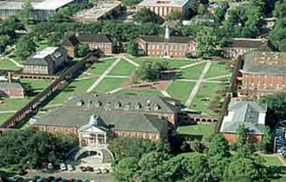

Policies and Guidelines Regarding Classroom Behavior
Student Life & Conduct
Buchanan Hall
Phone: 337.482.6373
Email: studentlife.conduct@louisiana.edu
1

Slide 2
Students and faculty have shared responsibility for maintaining an
appropriate learning environment
2

Slide 3
Faculty have the professional responsibility to treat students with understanding, dignity and respect. Students are expected to demonstrate appropriate, respectful behavior toward other members of the university community, both faculty and peers. Disruptive students in the academic setting hinder the educational process. Disruptive student conduct is prohibited by the Code of Student Conduct & Appeal Procedures, which also enumerates the formal actions that may be taken in such cases.
3

Slide 4

What constitutes a disruption?
4

Slide 5
“Disruption,” as applied to the academic setting, means behavior that a reasonable faculty member would view as interfering with normal academic functions.
Examples include, but are not limited to:
Persistently speaking without being recognized
Interrupting other speakers
Behavior that distracts the class from the subject matter or discussion
In extreme cases, physical threats, harassing behavior or personal insults
Refusal to comply with faculty direction
5

Slide 6
Prevention
6

Slide 7
The best time to deal with disruption is before it begins. Faculty can take steps to reduce the likelihood of disruptive behaviors in the classroom.
Explicitly state expectations for conduct in the syllabus. Include specifics, such as “turn off pagers and cell phones before entering the classroom.”
Explain consequences for inappropriate behavior.
Review these expectations with students during the first class meeting
Model respectful communication with your students
Facilitate respectful exchange of ideas among your students.
Respond to problems consistently and in a timely manner
7

Slide 8

Handling classroom
disruptions
8

Slide 9
In cases of IMMEDIATE THREAT to you or others, immediately call University Police at
337-482-6447.
Otherwise….
9

Slide 10
1. Have a private conversation with the student to discuss the disruptions you are observing and possible remedies for the situation.
The faculty member may want to follow up with a written summary to the student, re-stating your expectations and consequences for continued disruption. You may copy the Dean of Students and /or the Department of Student Life & Conduct.
(Step 2 is not recommended in all cases.)
10

Slide 11
3. Students who fail to respond to your attempts to rectify their disruption should be referred to the Department of Student Life & Conduct. Depending on the nature and level of disruption, either University Police or a Student Life & Conduct Dean may have to remove the student from the classroom. Upon notifying the Department of Student Life & Conduct, the Dean will attempt to make contact with the student before the next class.
4. Consulting your Department Head or College Dean may be helpful in developing a plan for dealing with a disruptive student.
11

Slide 12
5. Formal disciplinary action may include: Disciplinary reprimand, probation, suspension or dismissal from the University. Permanent removal from class must comply with the judicial process. It is advisable not to inform a student that he/she is permanently dismissed until the full procedure to effect such action has been completed.
12

Slide 13
6. Keep records of the difficulties, and your efforts to resolve them, including all written communication. These will be helpful in the case of formal actions. It is recommended that copies of your notes be sent to Department of Student Life & Conduct or Dean of Students Office.
13

Slide 14
Faculty are educators and academicians. Being forced into another role -such as counselor or disciplinarian- because of a student situation can be uncomfortable, and/or awkward. In such situations, consider consulting with campus resources that may be helpful in resolving issues with the student.
A range of support and informational services are available to faculty and to students: Dean of Students Office, Department of Student Life & Conduct, Counseling & Testing Center, University Police, and Office of Disability Services.
14

Slide 15
**Although some disruptive students may have emotional or mental disorders and thus are disabled and protected under the Rehabilitation Act (ADA), they are held to the same standards of conduct as all other students.**
15

Slide 16

ACADEMIC DISHONESTY
16

Slide 17
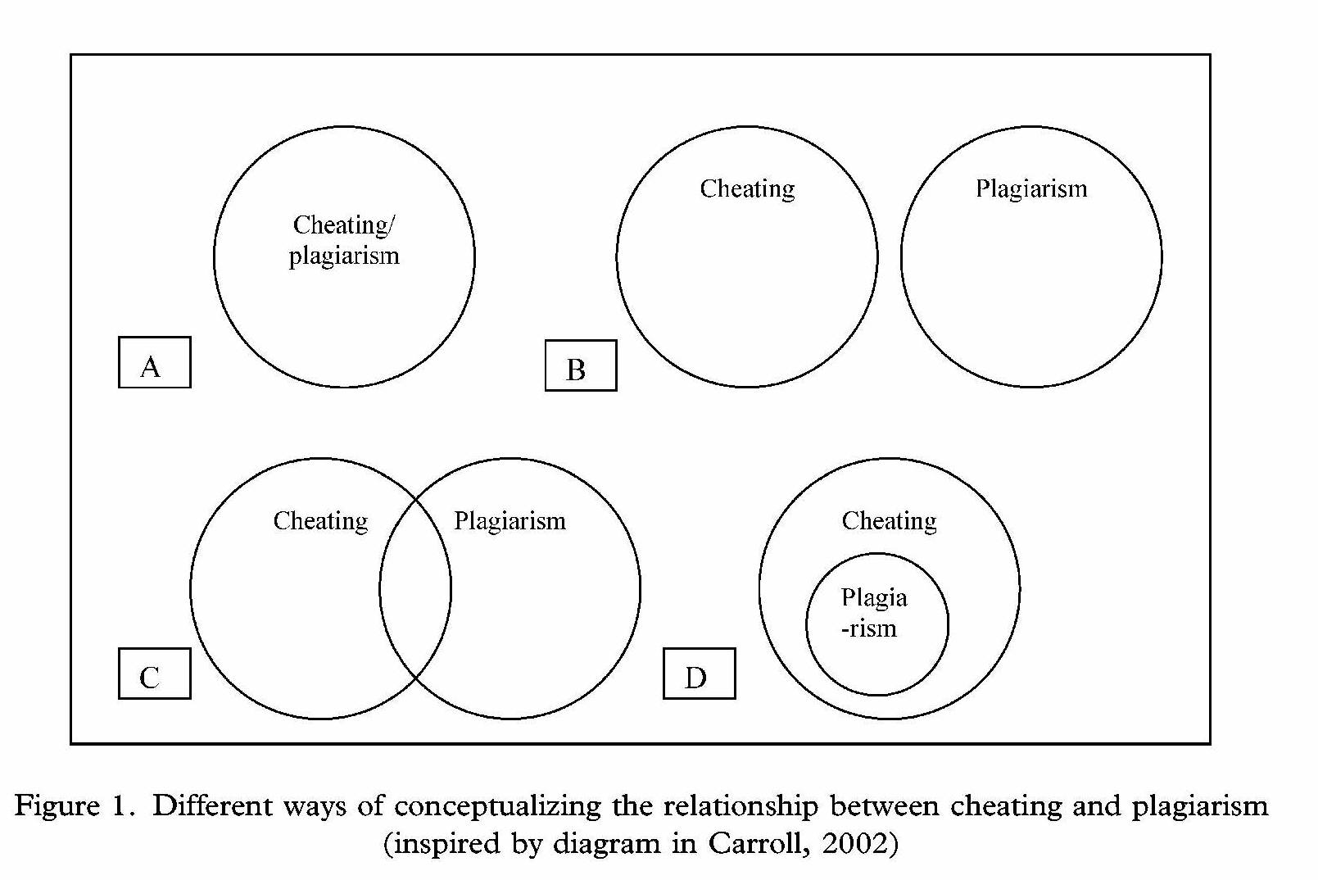
Buggey, T. (2007, Summer). Storyboard for Ivan's morning routine. Diagram. Journal of Positive Behavior Interventions, 9(3), 151.

Slide 18
DEFINITIONS OF CHEATING AND PLAGIARISM
1) Cheating, in the context of academic matters, is the term broadly used to describe all acts of dishonesty committed in the taking of tests or examinations and in the preparation of assignments. Cheating includes but is not limited to such practices as gaining help from another person, using crib notes, relying on a calculator or any current technology if such aids have been forbidden. Preparing an assignment in consultation with another person when the instructor expects the work to be done independently is also considered cheating. In other words, cheating occurs when a student makes use of any unauthorized aids or materials. Furthermore, any student who provides unauthorized assistance in academic work is also guilty of cheating.
18

Slide 19
Plagiarism
Plagiarism is a specific type of cheating.
It occurs when a student passes off as their own the ideas or words of another person, when a student presents as a new and original idea or product anything which in fact is derived from an existing work, or when a student makes use of any work or production already created by someone else without giving credit to the source.
In short, plagiarism is the use of unacknowledged materials in the preparation of assignments. Thus, the student must take care to avoid plagiarism by research or term papers, art projects, architectural designs, musical compositions, science reports, laboratory experiments, and the like.

Slide 20
How to Handle Cheating and Plagiarism
Those of us in the profession of education agree that cheating/plagiarism incidents are not always easy to handle. It is sometimes challenging to those who report such incidents, to those who have to confront the students and to those who are responsible for making the final decisions in concluding the case. Yet we know that cheating/plagiarism presents an unfair standard, is wrong and must be addressed.
20

Slide 21
Academic Dishonesty Cases
(* 9/12/2013)
Source: Student Life & Conduct StarRez Database
21

Slide 22
Faculty member would proceed accordingly.
1) The student(s) should be talked to in private and confronted with the charge.
2) The faculty member should allow the student to admit or deny the charge.
3) The faculty member may choose at that time to indicate to the student his/her belief of the charge or decide to indicate to the student that a final decision will be made and that the student will be notified either by the faculty member or by the Department Student Life & Conduct.
*Faculty may proceed with step 1 or choose to go directly to step 5
22

Slide 23
4) The faculty member would at this time complete the Academic Dishonesty Report and forward to the Department of Student Life & Conduct. If the Department of Student Life & Conduct discovers that this student has a history of cheating, the faculty member will be contacted and a final decision will be made regarding the appropriate discipline in this case.
5) The faculty member may chose to refer the information to the Department of Student Life & Conduct to handle the entire case. The faculty member would complete the Academic Dishonesty Report and forward to the Department of Student Life & Conduct. The faculty member will be contacted by the Department of Student Life & Conduct if it is discovered that the student is a repeat offender of cheating/plagiarism.
23

Slide 24
Faculty member chooses to handle in conjunction with the Department of Student Life & Conduct.
If you choose this route, our office will assist you in any manner you choose.
We will either advise or assist you in assessing sanctions.
We could charge the student with a violation of the Code of Student Conduct.
In extreme cases where cheating warrants dismissal, our office would charge the student to appear before the Student Discipline Committee and request dismissal/suspension from the University
24

Slide 25
We are concerned that academic dishonesty is not being reported.
1) Cheating handled within the department
If you receive a report of a student cheating or plagiarizing, you have the authority as a faculty member to investigate and/or collect any evidence and give an appropriate penalty.
If you catch a student who has either cheated or plagiarized, the faculty may assign a "zero" for the assignment/test in question or assign an F in the course.
25

Slide 26
A faculty member may choose another option: under other on the form. Other can be something less than “zero” or “F” or more than, or in addition to.
We request that whenever you sanction a student for cheating or plagiarism, you notify our office via the Academic Dishonesty Report (so that we may keep records in the event the student ever cheats again during his tenure at the University.)
26

Slide 27
When using webpage:
Forward one copy to
Student Life and Conduct
Give one copy to student
Keep one copy for your records.

Slide 28
Tips to be proactive about Academic Dishonesty
State policies and penalties on syllabus
Communicate to your students what you expect and how you will handle academic dishonesty the first class session.
Make arrangements to prevent cheating (i.e. test seating, moving around the room, making eye contact with students who look up, etc.)
Require students to submit their papers electronically. Archive the papers and reference them in future classes if you suspect another student has submitted the same paper.
If you suspect plagiarism, use a free full-text search engine like www.google.com or www.find-same.com
28

Slide 29
Resources:
Online Cheating A New Twist to an Old Problem
http://owl.english.purdue.edu/owl/
http://www.plagiarism.org/

Slide 30
University Ombudsman
Coronna Hall Rm. 216
(337) 482-6947
Email: ombudsman@louisiana.edu
The University Ombudsman is responsible for informing students of their rights in the process of grade and disciplinary appeals. The Ombudsman is available to all students in need of advice.

Slide 31
Contact Information
Gregory G. Zerangue
Student Life & Conduct
Buchanan Hall, 1st floor
Phone: 337.482.6373
Email: studentlife.conduct@louisiana.edu
31

